Slide 1
Data Link Layer

Slide 2
DATA LINK LAYER AND LAN
LINK LAYER SERVICES
Link Layer Services
Framing
Flow Control
Error Control
Media Access Control
Ethernet
Wireless LAN–Introduction about Bluetooth, Zigbee.

Slide 3
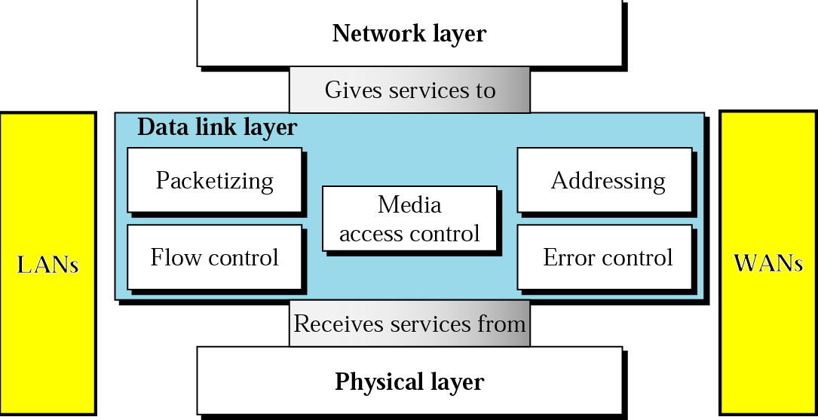
OVERVIEW OF DLL
The data link layer transforms the physical layer, a raw transmission facility, to a link responsible for node-to-node (hop-to-hop) communication.
Specific responsibilities of the data link layer include
Framing, Addressing, Flow control, Error control, and Media access control.
2

Slide 4
DATA LINK LAYER
For the most part, the link layer is implemented in a network adapter, also sometimes known as a network interface card (NIC).
At the heart of the network adapter is the link-layer controller, usually a single, special-purpose chip that implements many of the link-layer services (framing, link access, error detection, and so on).
Thus, much of a link-layer controller’s functionality is implemented in hardware.

Slide 5
DLL DESIGN ISSUES
1. services provided to the network layer : The function of the data link layer is to provide services to the network layer.
2. Framing
Group the physical layer bit stream into units called frames.
Frames are nothing more than "packets" or "messages".
By convention, we use the term "frames" when discussing DLL.

Slide 6
DLL DESIGN ISSUES
2. Error Control
To ensure that the information received by the receiver is exactly the information transmitted by the sender.
3. Flow Control
Prevent a fast sender from overwhelming a slower receiver.

Slide 7
SERVICES PROVIDED TO THE NETWORK LAYER
The principal service is transferring data from the network layeron the source machine to the network layer on the destination machine.
The data link layer can be designed to offer various services. The actual services offered can vary from system to system.
Three reasonable possibilities that are commonly provided are
Unacknowledged Connectionless service
Acknowledged Connectionless service
Acknowledged Connection-Oriented service
5

Slide 8
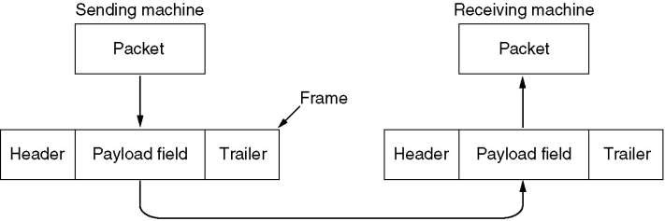

Slide 9
UNACKNOWLEDGED CONNECTIONLESS SERVICE
The source machine send independent frames to the destination machine without having the destination machine acknowledge them.
No logical connection is established beforehand or released afterward.
If a frame is lost due to noise on the line no attempt is made to detect the loss or recover from it in the data link layer.
This class of service is appropriate when the error rate is very low so that recovery is left to higher layers.
It is also appropriate for real - time traffic, such as voice, in which late data are worse than bad data.
Most LANs use unacknowledged connectionless service in the data link layer.
6

Slide 10
ACKNOWLEDGED CONNECTIONLESS SERVICE
When this service is offered, there are still no logical connections used, but each frame sent is individually acknowledged.
The sender knows whether a frame has arrived correctly.
If it has not arrived within a specified time interval, it can be sent again.
This service is useful over unreliable channels, such as wireless systems.
Adding Ack in the DLL rather than in the Network Layer is just an optimization and not a requirement.
On reliable channels, such as fiber, the overhead of a heavy weight data link protocol may be unnecessary, but on wireless channels, with their inherent unreliability, it is well worth the cost.

Slide 11
ACKNOWLEDGED CONNECTION ORIENTED SERVICE
Here, the source and destination machines establish a connection before any data are transferred.
Each frame sent over the connection is numbered, and the data link layer guarantees that each frame sent is indeed received.
Furthermore it guarantees that each frame is received exactly once and that all frames are received in the right
order.

Slide 12
ACKNOWLEDGED CONNECTION ORIENTED SERVICE
When connection-oriented service is used, transfers go through three distinct phases.
In the first phase, the connection is established by having both sides initialize variables and counters needed to keep track of which frames have been received and which ones have not.
In the second phase, one or more frames are actually transmitted
In the third and final phase, the connection is released, freeing up the variables, buffers, and other resources used to maintain the connection.

Slide 13
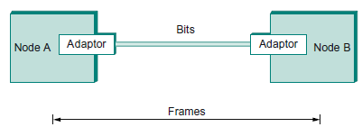
FRAMING
Blocks of data (called frames), are exchanged between nodes at data link layer.
Network adaptor that enables the nodes to exchange frames.
The structure of the frame is specified by the link-layer protocol.
Central Challenge faced by the adaptor.[Framing Problem]
Recognizing exactly what set of bits constitutes a frame.
Determining where the frame begins and ends
There are several ways to address the framing problem.

Slide 14
Framing
The data link layer, needs to pack bits into frames, so that each frame is distinguishable from another.
Our postal system practices a type of framing.
The simple act of inserting a letter into an envelope separates one piece of information from another;
the envelope serves as the delimiter.
each envelope defines the sender and receiver addresses.

Slide 15
Framing
Framing in the data link layer separates a message from one source to a destination by adding a sender address and a destination address.
The destination address defines where the packet is to go; the sender address helps the recipient acknowledge the receipt.
Although the whole message could be packed in one frame, that is not normally done.
One reason is that a frame can be very large, making flow and error control very inefficient.
When a message is carried in one very large frame, even a single-bit error would require the retransmission of the whole message.
When a message is divided into smaller frames, a single-bit error affects only that small frame.

Slide 16
FRAMING
DLL translates the physical layer's raw bit stream into discrete units (messages) called frames.
How can frame be transmitted so the receiver can detect frame boundaries?
That is, how can the receiver recognize the start and end of a frame?

Slide 17
Framing
Frames can be of fixed or variable size.
Fixed-Size Framing
There is no need for defining the boundaries of the frames.
The size itself can be used as a delimiter.
Example Protocols:
ATM wide-area network, which uses frames of fixed size called cells.
Variable-Size Framing
Need a way to define the end of the frame and the beginning of the next.
Two approaches were used for this purpose:
Byte(character)-oriented approach
Bit-oriented approach.

Slide 18
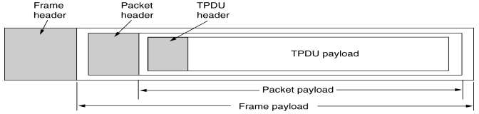
FRAMING
Character Count
Flag byte with Byte Stuffing
Bit stuffing

Slide 19
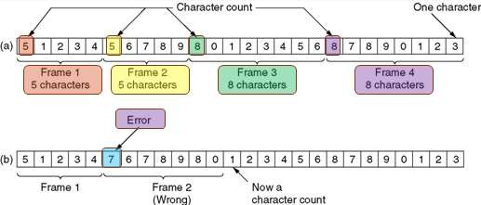
FRAMING – CHARACTER COUNT
The first framing method uses a field in the header to specify the number of characters in the frame.
When the data link layer at the destination sees the character count, it knows how many characters follow and hence where the end of the frame is.
The trouble with this
transmission error.
algorithm
is that
the count
can be garbled by a
11

Slide 20
Framing
Byte-Oriented Protocols.
View each frame as a collection of bytes(characters) rather than a collection of bits.
Example protocols:
Binary Synchronous Communication (BISYNC) protocol developed by IBM in the late 1960s
Digital Data Communication Message Protocol (DDCMP) used in Digital Equipment Corporation’s DECNET
Point-to-Point Protocol (PPP) which is more recent and widely used.

Slide 21

Byte-oriented protocol Example: PPP
Commonly used to carry Internet Protocol packets over various sorts of point-to-point links.
Uses special characters known as sentinel characters to indicate where frames start and end. It uses character stuffing.
Frame Format:
Start-of-Text character Flag : 01111110
Address and Control fields: Usually contain default values.
Protocol field: Used for demultiplexing and it identifies the high-level protocol such as IP or IPX.
Frame payload: Size can be negotiated, but it is 1500 bytes by default.
Checksum field: It is either 2 (by default) or 4 bytes long

Slide 22
Byte-Oriented Protocols
In character - oriented framing, data is transmitted as a sequence of bytes, from an 8-bit coding system like ASCII. The parts of a frame in a character - oriented framing are
Frame Header: It contains the source and the destination addresses of the frame in form of bytes.
Payload field: It contains the message to be delivered. It is a variable sequence of data bytes.
Trailer: It contains the bytes for error detection and error correction.
Flags: Flags are the frame delimiters signaling the start and end of the frame. It is of 1- byte denoting a protocol - dependent special character.

Slide 23
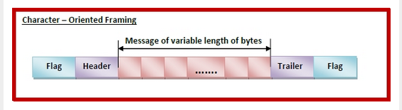
Byte-Oriented Protocols

Slide 24
FRAMING – BYTE STUFFING
Character - oriented protocols are suited for transmission of texts.
However, if the protocol is used for transmitting multimedia messages, there are chances that the pattern of the flag byte is present in the message byte sequence.
If this happens, the receiver, when it encounters this pattern in the middle of the data, thinks it has reached the end of the frame.
To fix this problem, a byte-stuffing strategy was added to character-oriented framing.
Here, a special byte called the escape character (ESC) is stuffed before every byte in the message with the same pattern as the flag byte.

Slide 25
FRAMING – BYTE STUFFING
Byte stuffing by the escape character allows the presence of the flag in the data section of the frame, but it creates another problem.
What happens if the text contains one or more escape characters followed by a flag?
The receiver removes the escape character, but keeps the flag, which is incorrectly interpreted as the end of the frame.
To solve this problem, the escape characters that are part of the text must also be marked by another escape character.
In other words, if the escape character is part of the text, an extra one is added to show that the second one is part of the text.

Slide 26
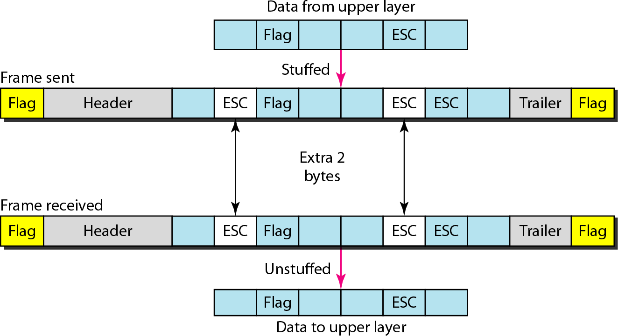
Byte stuffing and unstuffing
14

Slide 27
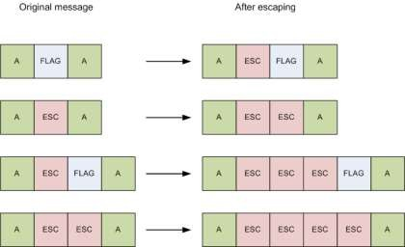
13

Slide 28
Character - Oriented Framing - problem
The problem with character - oriented framing is that it adds too much overhead on the message, thus increasing the total size of the frame.
Another problem is that not all architectures are byte oriented. (the coding system used in recent times have 16-bit or 32-bit characters that conflicts with the 8-bit encoding).

Slide 29
Bit-oriented Framing
In bit-oriented framing, data is transmitted as a sequence of bits that can be interpreted in the upper layers both as text as well as multimedia data.
The parts of a frame in a bit - oriented framing are
Frame Header − It contains bits denoting the source and the destination addresses of the frame.
Payload field − It contains the message to be delivered. It is a variable sequence of bits.
Trailer − It contains the error detection and error correction bits.
Flags − Flags are a bit pattern that act as the frame delimiters signaling the start and end of the frame.
It is generally of 8-bits and comprises of six or more consecutive 1s. Most protocols use the 8-bit pattern 01111110 as flag

Slide 30
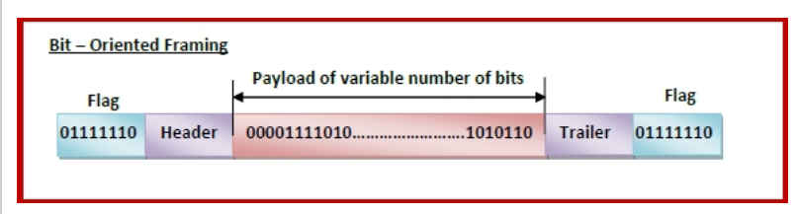
Bit-oriented Framing

Slide 31
FRAMING – BIT STUFFING
Whenever the sender's data link layer encounters five consecutive 1s in the data, it automatically stuffs a 0 bit into the outgoing bit stream.
This bit stuffing is analogous to byte stuffing, in which an escape byte is stuffed into the outgoing character stream before a flag byte in the data.
When the receiver sees five consecutive incoming 1 bits, followed by a 0 bit, it automatically destuffs (i.e., deletes) the 0 bit
Bit - oriented protocols are suited for transmitting any sequence of bits.
15

Slide 32
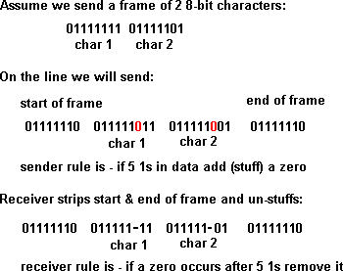
BIT STUFFING EXAMPLE

Slide 33
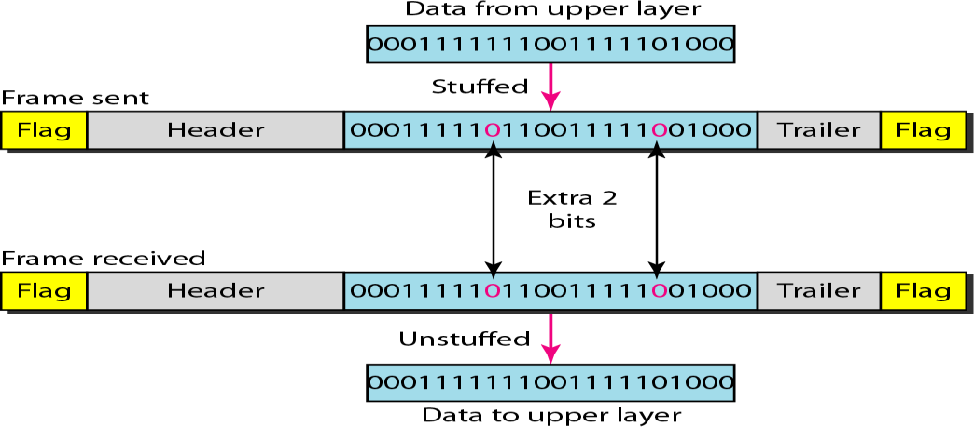
Bit stuffing and unstuffing
17

Slide 34

Bit-oriented protocol Example: HDLC
Frame Format:
Beginning and Ending sequence: 01111110
Transmitted when the link is idle to keep the sender and receiver clock synchronized.
Uses bit stuffing.
Working:
Sender:
Any time five consecutive 1s have been transmitted from the body of the message (i.e., excluding when trying to transmit the distinguished 01111110 sequence), the sender inserts a 0 before transmitting the next bit.
Receiver:
Should five consecutive 1s arrive, the receiver makes its decision based on the next bit it sees.
If the next bit is a 0
it must have been stuffed, and so the receiver removes it.
If the next bit is a 1
Either this is the end-of-frame marker (or)
the last 8 bits it has looked at are 01111110
(ie) it sees a 0
An error has been introduced into the bit stream(discarded)
the last 8 bits it has looked at are 01111111
(ie) it sees a 1

